Slide 1
ANGULAR 18
Presented by: Amr Mohsen
Tech lead : Ahmed Hussein

Slide 2
Key features and updates in Angular 18
Angular.dev is now the new home for Angular developers
Material 3, deferrable views, built-in control flow are now stable and incorporate a series of improvements
Experimental support for zoneless change detection
Improvements in server-side rendering
Improved debugging experience
Specifying a fallback content for ng-content
Unified control state change events
Route redirects as functions

Slide 3
What is zone js?
A Zone is an execution context that persists across async tasks. In other words, all the async tasks such as setTimeout, Promise, XHRs etc. are executed in a particular context. In case of zone.js, all these async tasks are executed in a single context which is called Zone
enables Angular to perform change detection and update the UI when asynchronous operations complete.

Slide 4
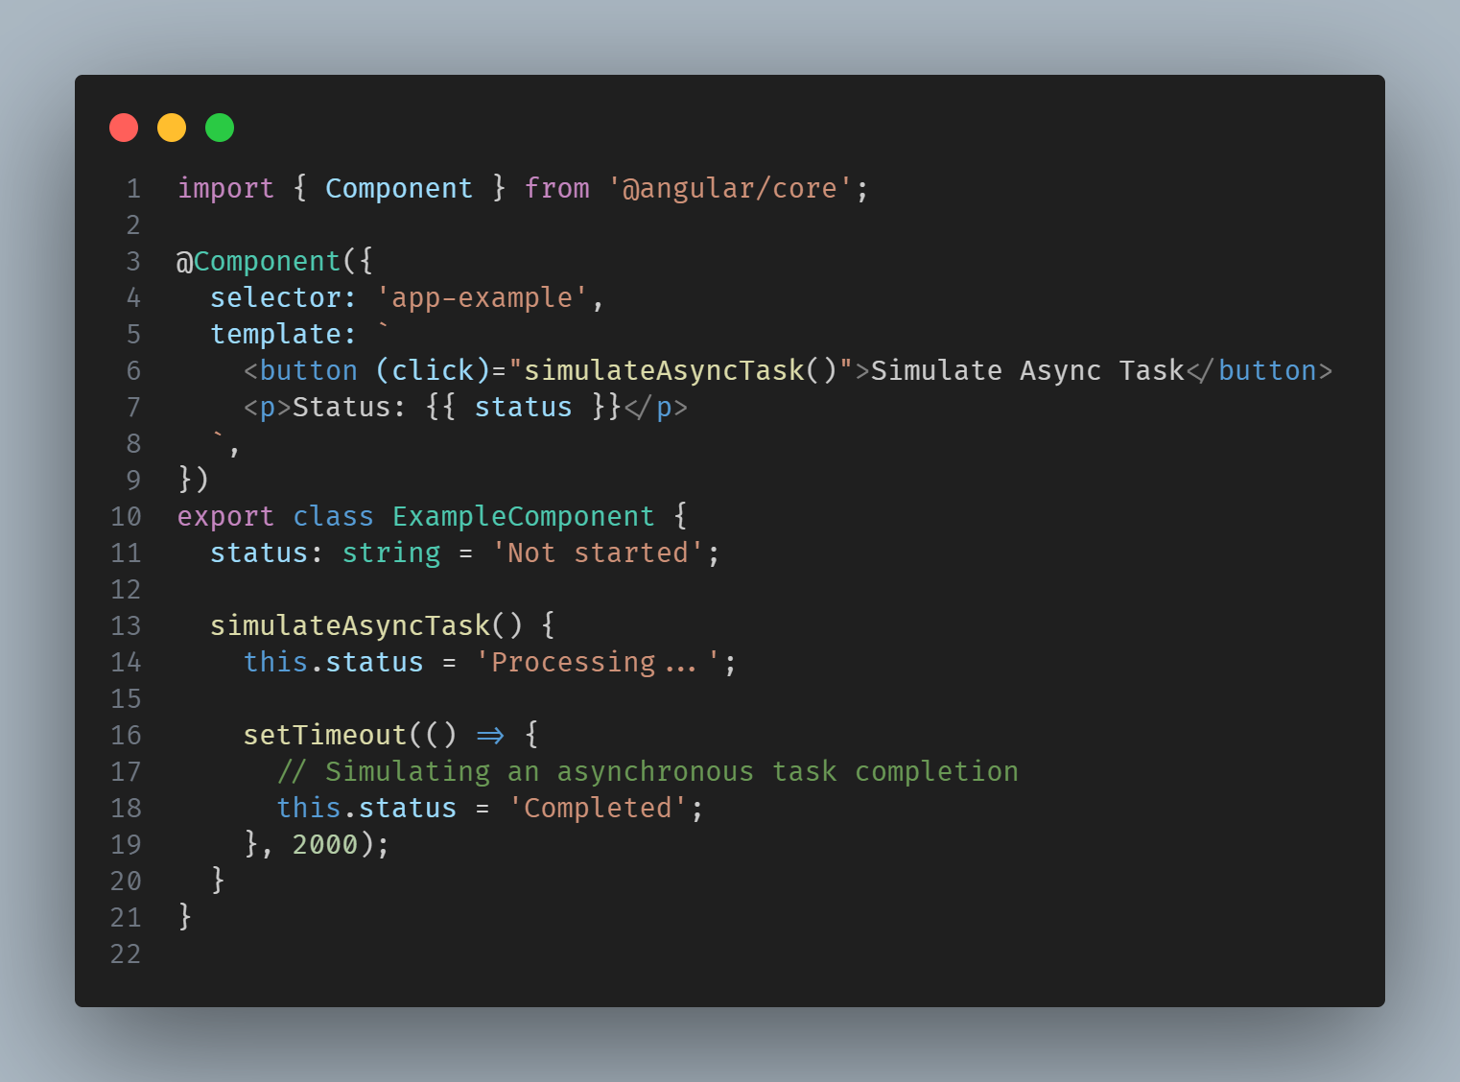

Slide 5
Using zone JS in angular
Behind the scenes, Zone.js intercepts the `setTimeout` call and hooks into the asynchronous operation. It allows Angular to track the execution of the task and ensures that change detection is triggered when the task completes. When the timeout expires, the callback function is executed, and the `status` property is updated to indicate that the task is completed. As a result, the UI is automatically updated to reflect the new status.
Visit : https://medium.com/swlh/what-is-zone-js-and-how-can-i-use-it-63ce08a55962

Slide 6
Experimental support for zoneless change detection
Improving composability for micro-frontends and interoperability with other frameworks
Faster initial render and runtime
Smaller bundle size and faster page loads
More readable stack traces
Simpler debugging

Slide 7
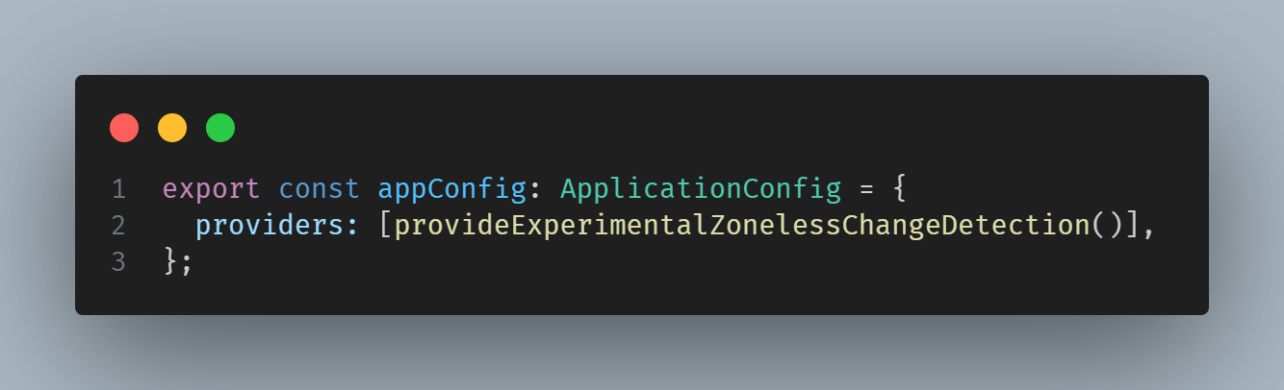
Using provideExperimentalZonelessChangeDetection

Slide 8
Experimental support for zoneless change detection
This works similarly to an application using zone.js, with few differences.
With zone.js, Angular ran change detection any time application state might have changed.
Without zones, Angular limits this checking to fewer triggers, such as signal updates.
This change also includes a new scheduler with coalescing to avoid checking for changes multiple times consecutively.
If your components are compatible with Angular’s ChangeDetectionStrategy.OnPush change detection strategy, they should be mostly compatible with zoneless as well which will make their transition seamless!

Slide 9
Event Coalescing by default
Starting in v18, we’re using the same scheduler for zoneless apps and apps using zone.js with coalescing enabled. To reduce the number of change detection cycles in new zone.js apps, we’ve also enabled zone coalescing by default.
Visit : https://angular.dev/api/core/NgZoneOptions

Slide 10
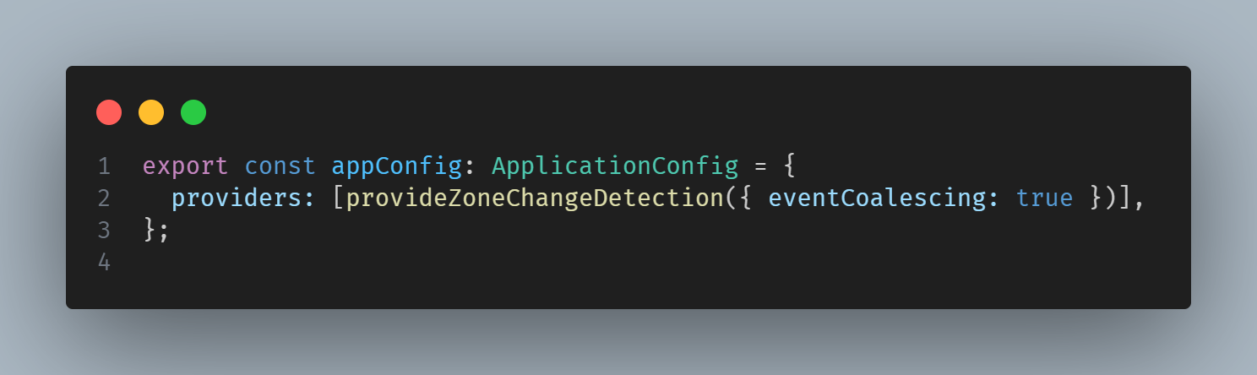
Event Coalescing

Slide 11
Components support zoneless
We enabled zoneless support in the Angular CDK and Angular Material. This also helped us to discover and polish some of the rough edges with the zoneless model.

Slide 12
Improvements in server-side rendering
About a year ago we introduced hydration and graduated it to stable in v17
There was one main blocker to get even more people to take advantage of hydration — lack of i18n support ,now hydration for i18n blocks is available in developer preview mode in v18!

Slide 13
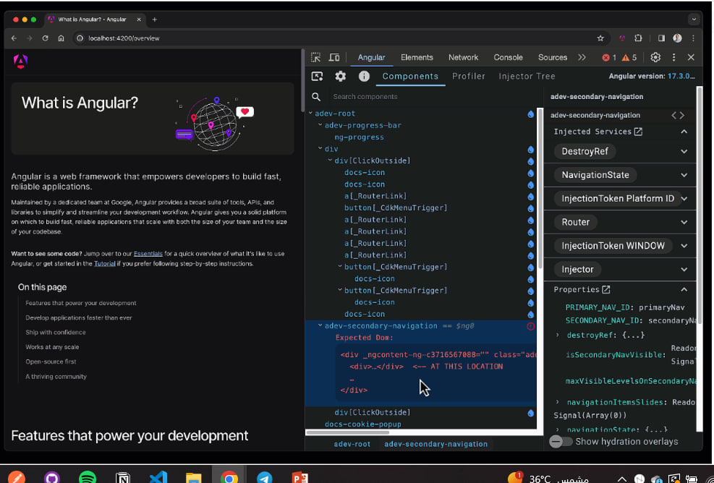
Improved debugging experience

Slide 14
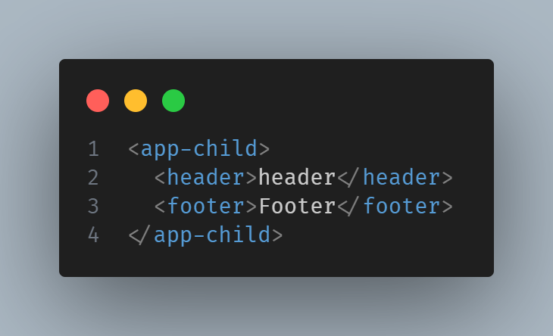
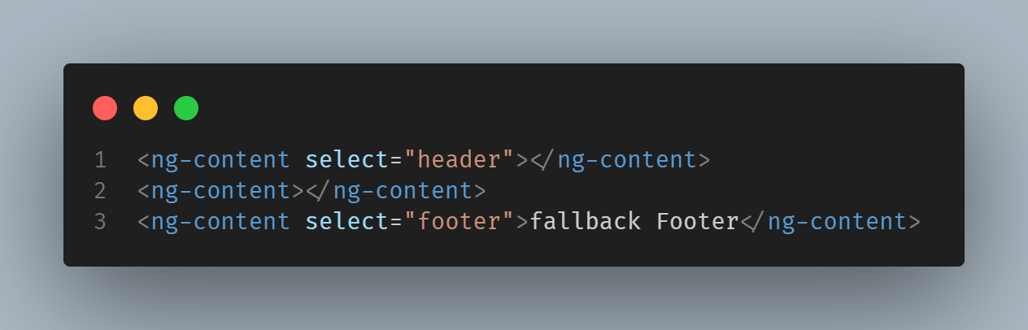
Specifying a fallback content for ng-content

Slide 15
Unified control state change events
FormControl, FormGroup and FormArray classes from Angular forms
now expose a property called events, which allows you to subscribe to a stream of events for this form control.
Using it you can track changes in value, touch state, pristine status, and the control status.

Slide 16
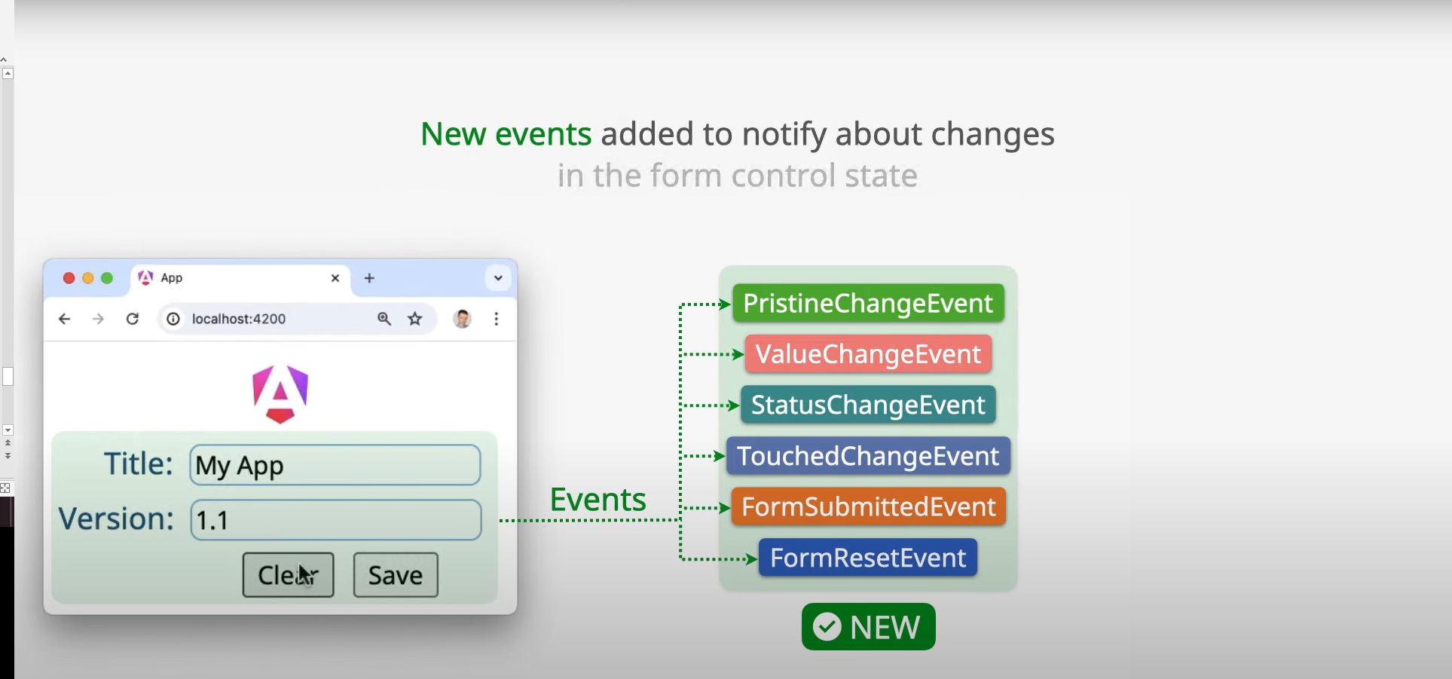
Unified control state change events

Slide 17
Route redirects as functions
To enable higher flexibility when dealing with redirects.
in Angular v18 redirectTo now accepts a function which returns a string.
For example, if you’d like to redirect to a route that depends on some runtime state you can implement a more complicated logic in a function:

Slide 18
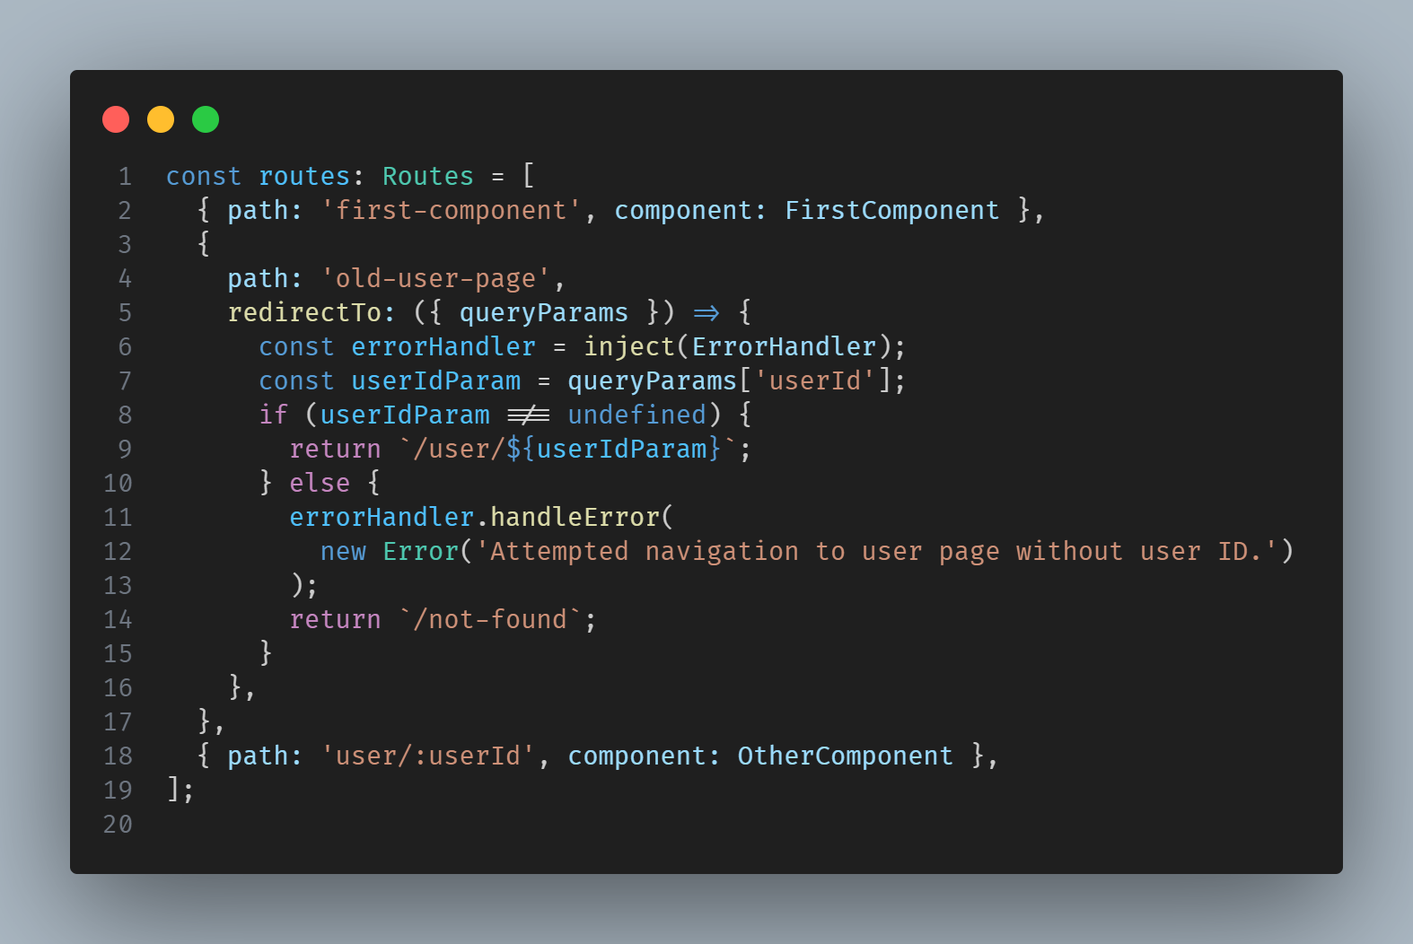
Route redirects as functions

Slide 19
Referances
https://dev.to/sandeepbalachandran/angular-18-features-5ajm
https://blog.angular.dev/angular-v18-is-now-available-e79d5ac0affe

Slide 20
Thank You
Amr Mohsen

